Slide 1
IOT Based Network Attached Storage
Building NAS (Network attached storage) ith the help of raspberry pi model 4 and recycling storage

Slide 2

Problem Statement
"Developing an Efficient and Private Cloud Storage Solution using Raspberry Pi and Repurposed Storage Devices"
The project aims to address the following key issues:
Waste and Sustainability
Cost-Effective Storage Solutions
Performance and Scalability

Slide 3
About Private Cloud Storage
"I don't need a hard disk in my computer if I can get to the server faster... carrying around these non-connected computers is byzantine by comparison."
- Steve Jobs
A dedicated cloud infrastructure that is exclusively used by a single organization.
Not shared with other organizations, providing a higher level of control and security.
Allows for the customization of storage configurations, hardware, and software components.

Slide 4




Components
Hardware Intergration
Network Connectivity
Shared Folder Integration
Smartphone Application
Old SSDs and HDDs are connected to Raspberry Pi boards, which serve as the central control units.
The Raspberry Pi boards are connected to the internet, allowing remote access to the NAS system. This connectivity enables users to access their data from anywhere with an internet connection.
A shared folder
developed, requiring users to log in with their unique credentials.
A dedicated smartphone application is designed to facilitate easy access to the NAS system.

Slide 5

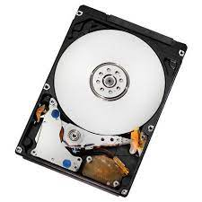
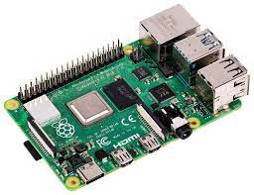
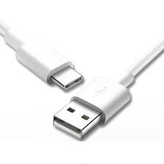

Hardware Components
Raspberry pi model 4
Recycled storage
Network
Cable and Adapters

Slide 6
Raspberry Pi model 4
The Raspberry Pi 4 Model B is a versatile and popular single-board computer known for its performance and flexibility. Here are the key specifications of this model:
Processor: Broadcom BCM2711, a Quad-core Cortex-A72 (ARM v8) 64-bit SoC running at 1.5 GHz.
Memory: Available in three variants: 4GB LPDDR4 SDRAM.
Graphics: VideoCore VI GPU supporting OpenGL ES 3.x, H.265 (4Kp60 decode), and HDMI 2.0.
Video Output: Two micro-HDMI ports, supporting dual monitor setups with resolutions up to 4K.
Audio Output: Combined 3.5mm audio and composite video output, and audio over HDMI.
Connectivity:
Gigabit Ethernet.
Dual-band 802.11ac wireless networking (2.4GHz and 5GHz) with Bluetooth 5.0 and BLE (Bluetooth Low Energy).
USB Ports: Four USB ports (two USB 3.0 and two USB 2.0).
Power Supply: USB-C power port, typically requiring a 5V/3A supply.
Storage: MicroSD card slot for loading the operating system and storing files. It also has a USB 3.0 port for connecting external storage devices.

Slide 7
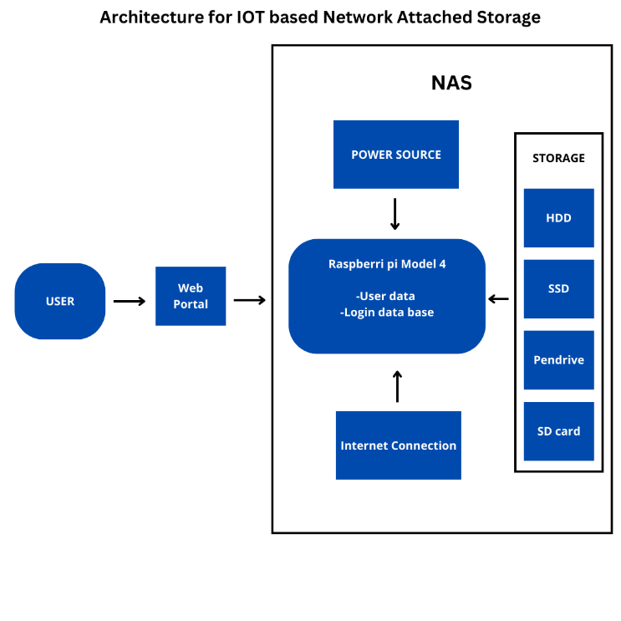

Slide 8
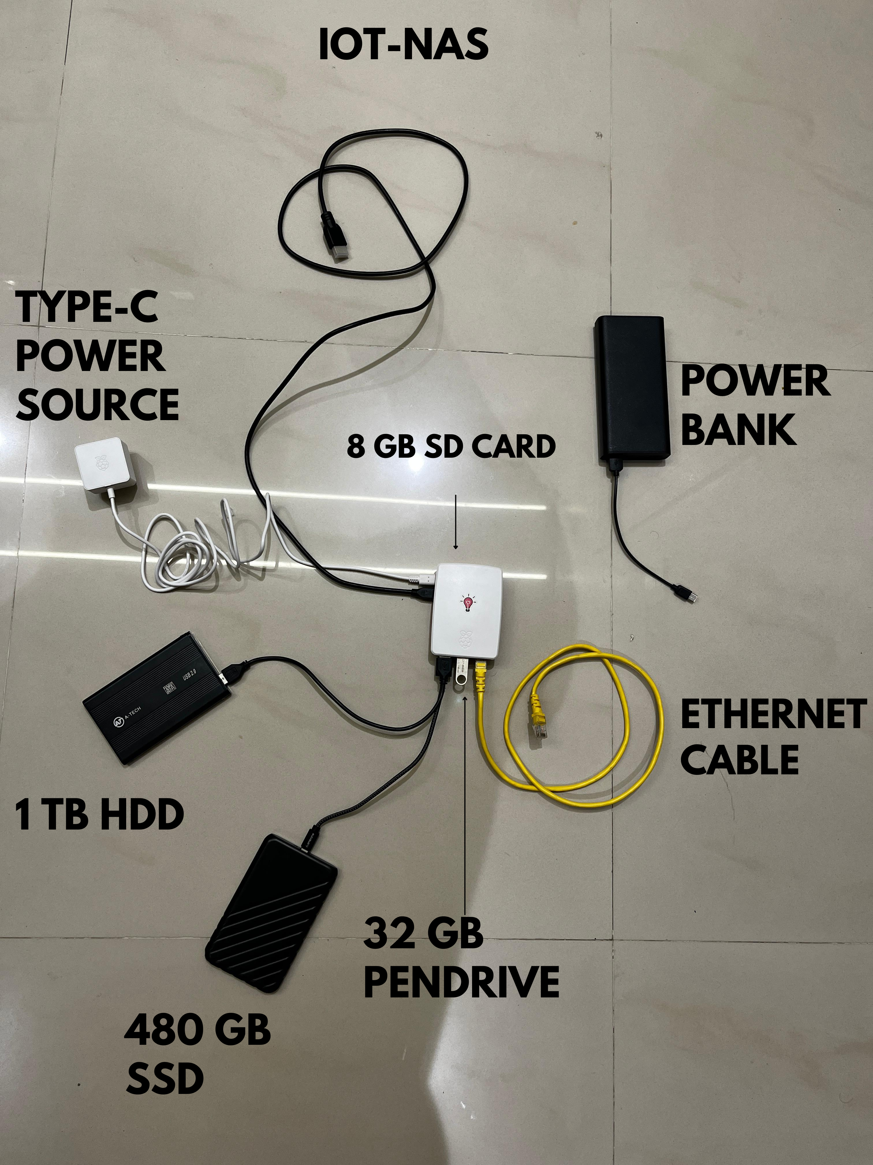
Introducing NAS-T

Slide 9



Impact of Private Cloud Storage
Cost-Efficiency
Customizability
Privacy and Security
Learning Opportunity
Local Access and Low Latency

Slide 10
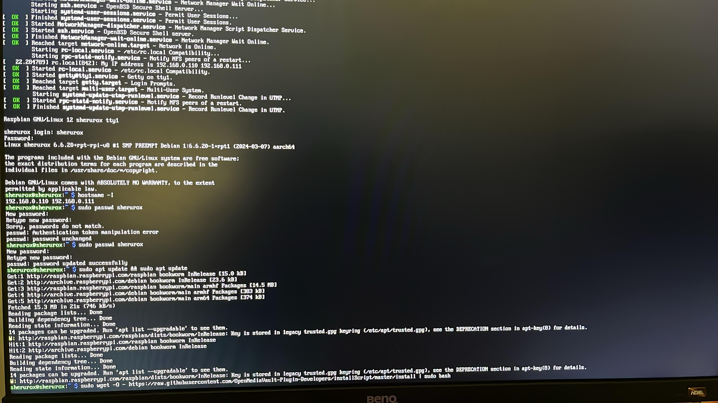

Slide 11
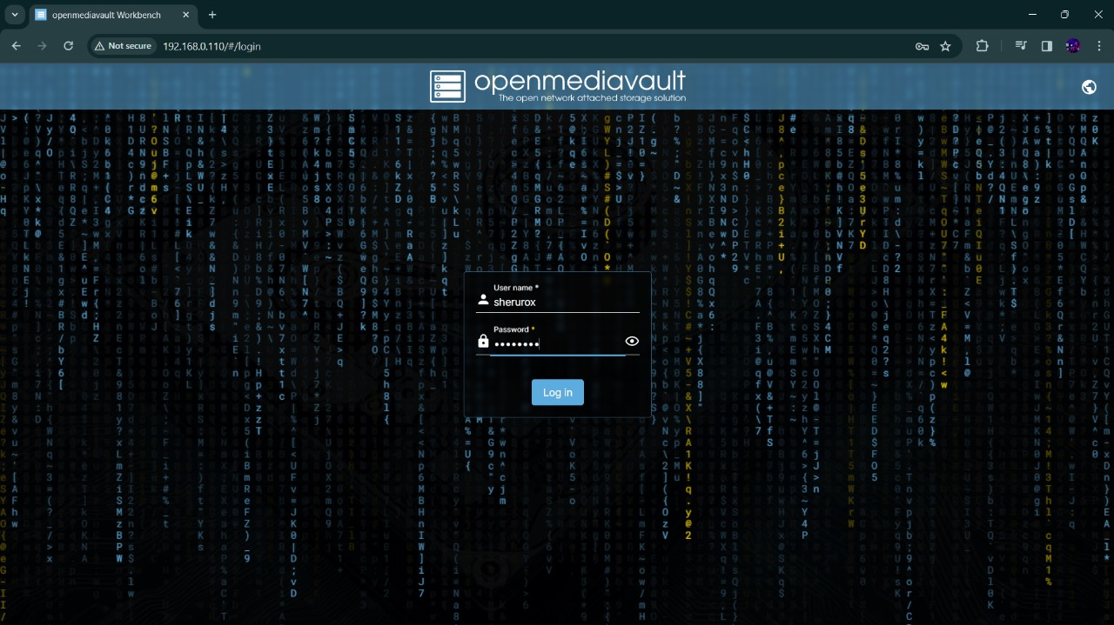

Slide 12
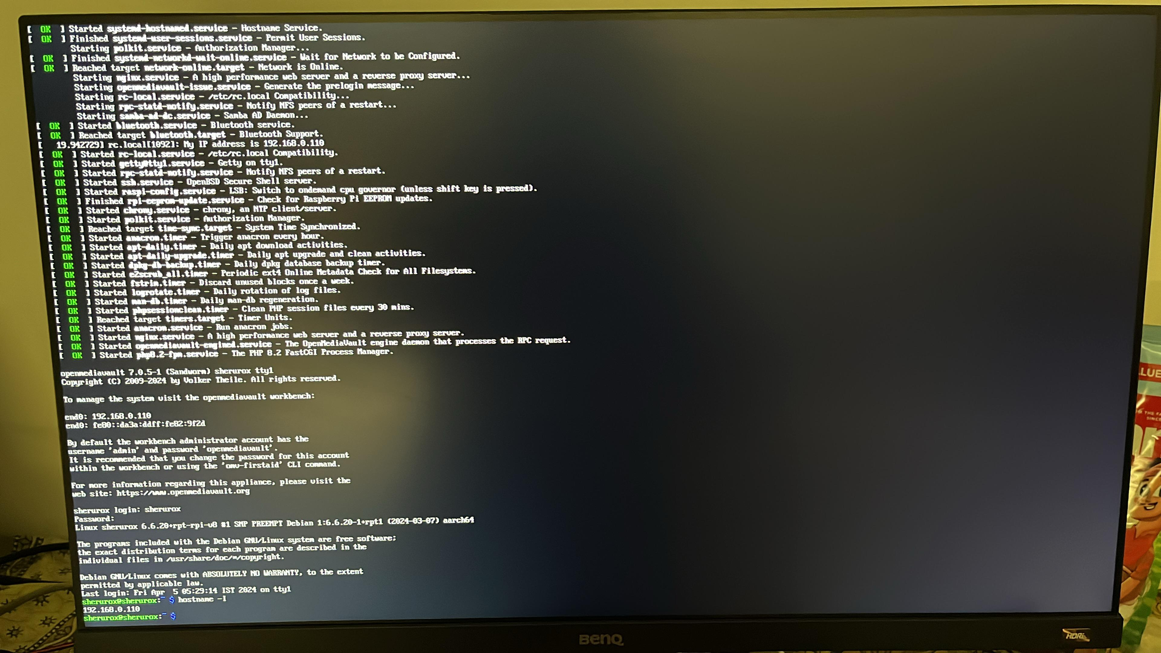

Slide 13
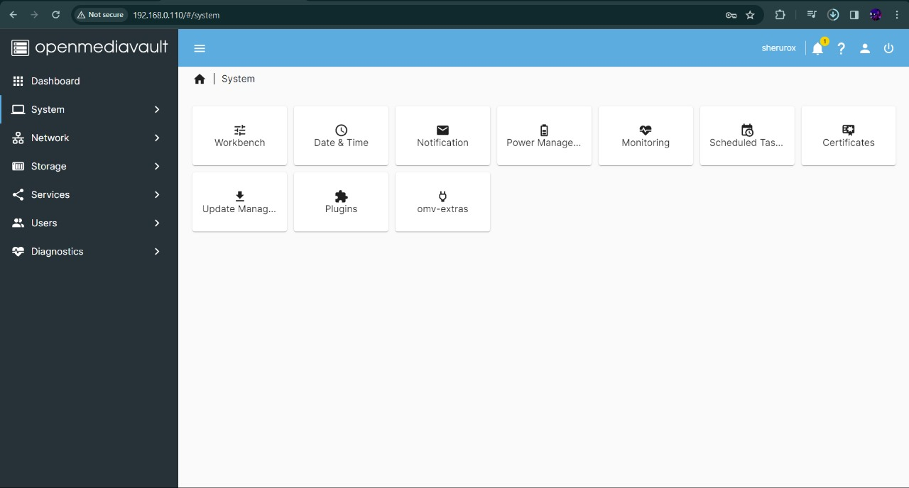

Slide 14
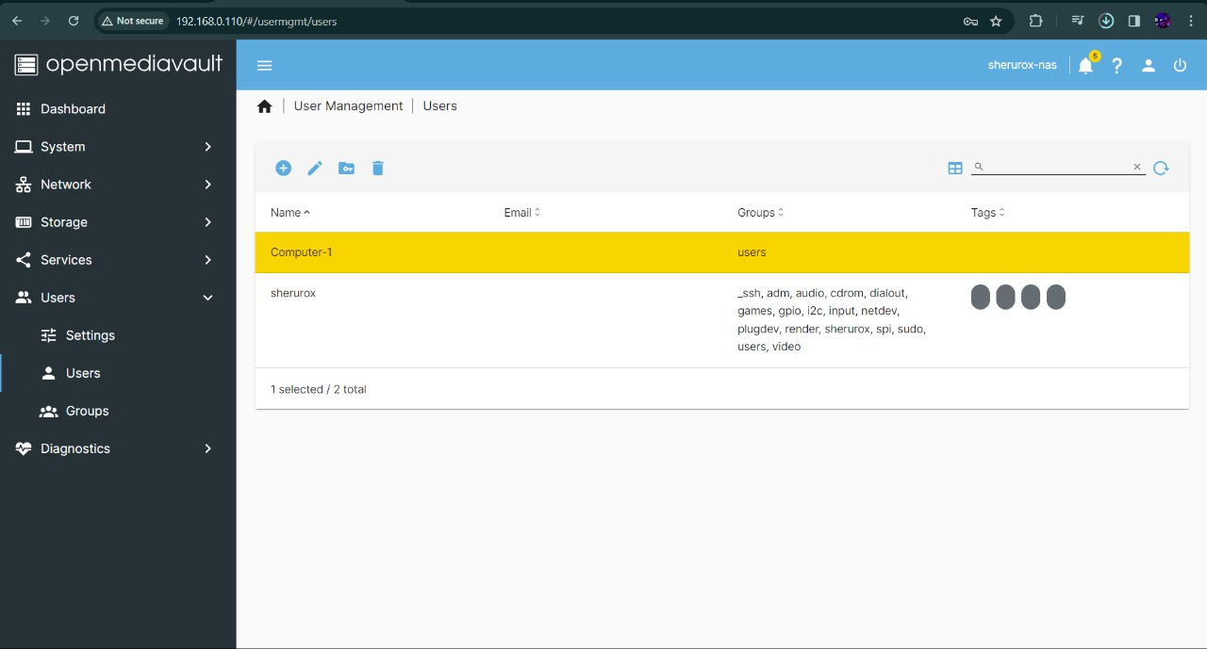

Slide 15
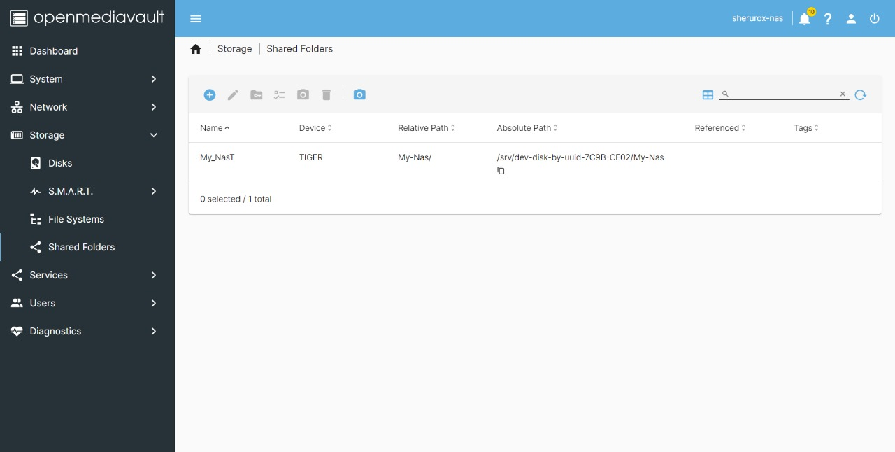

Slide 16
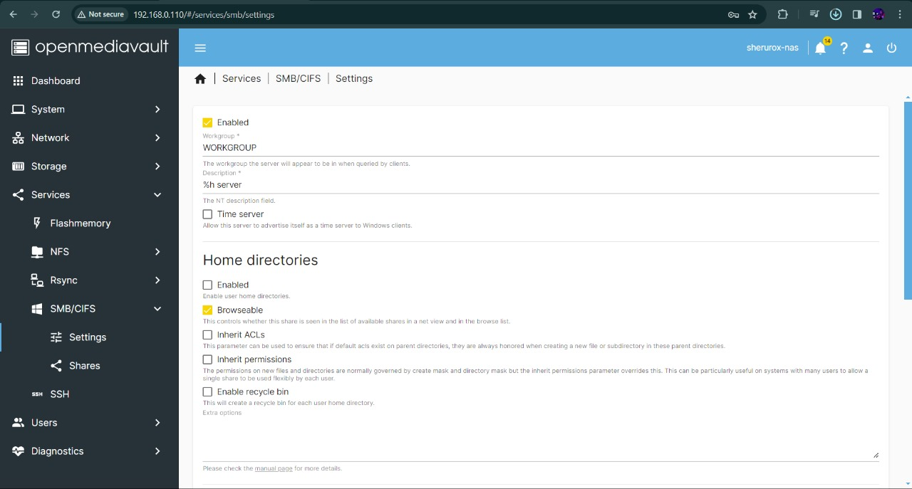

Slide 17
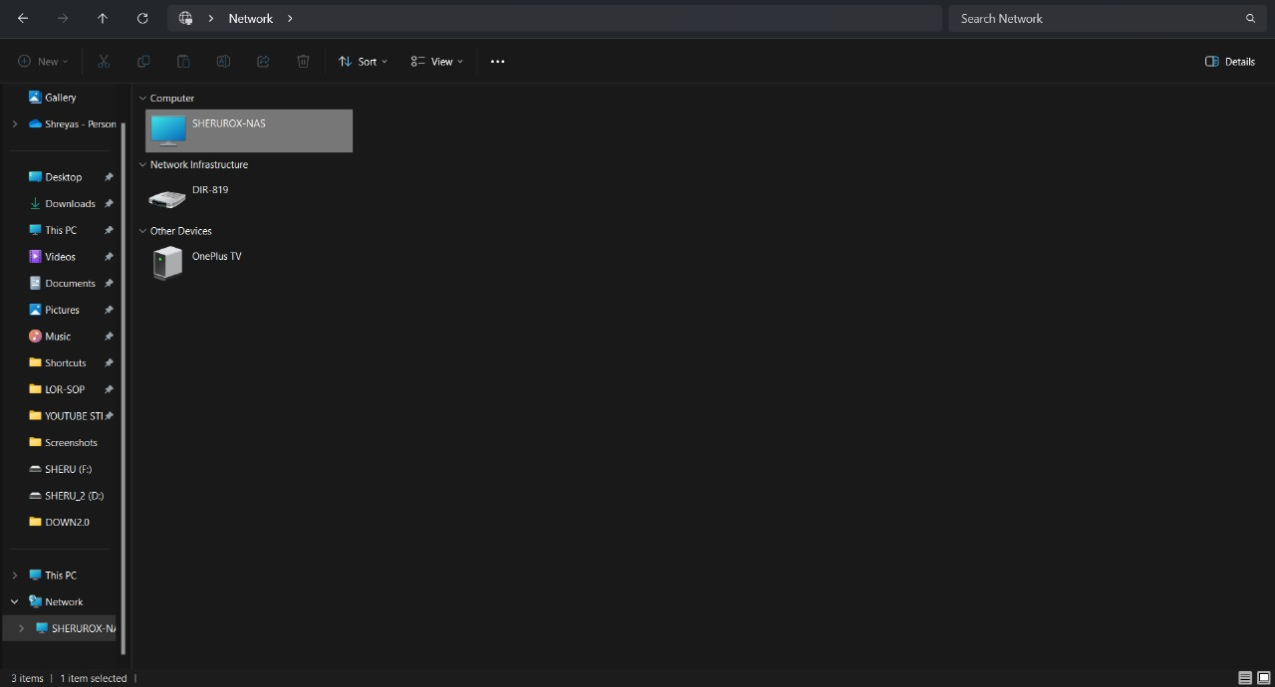

Slide 18
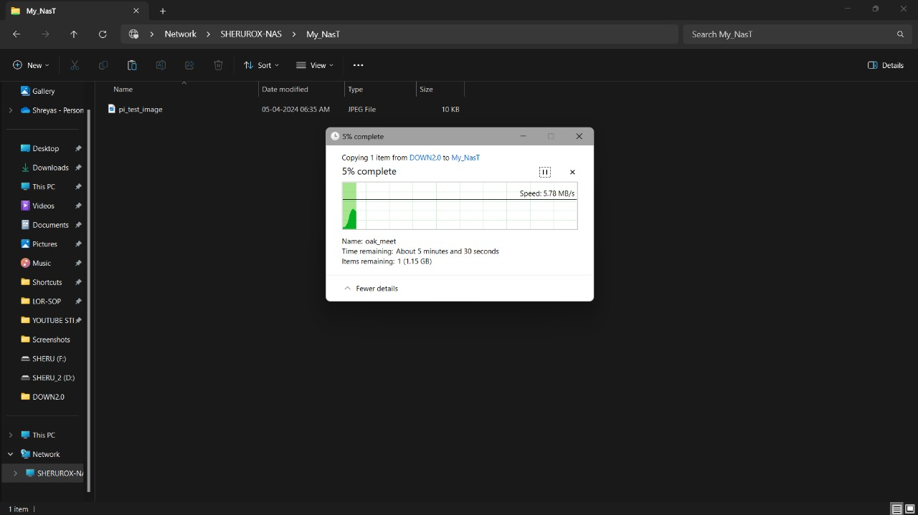

Slide 19
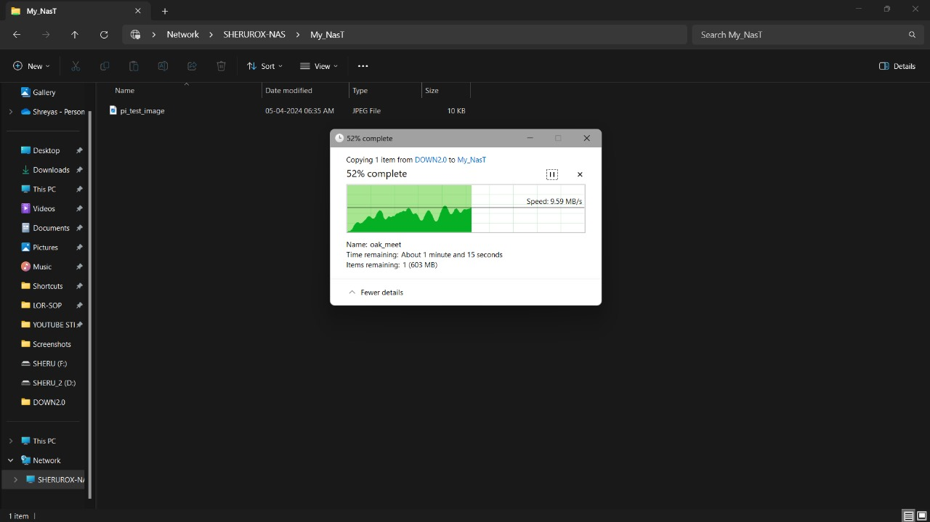

Slide 20
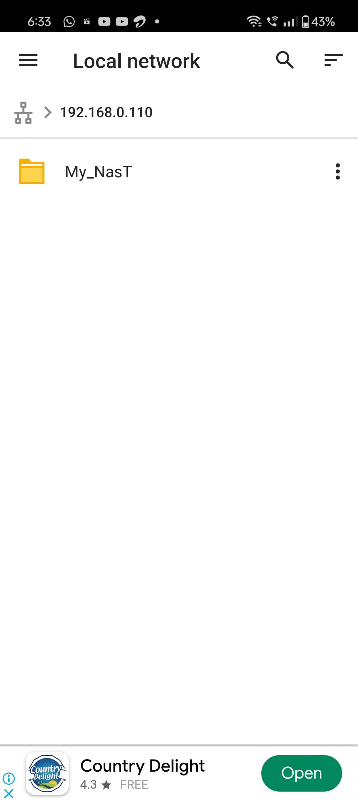

Slide 21
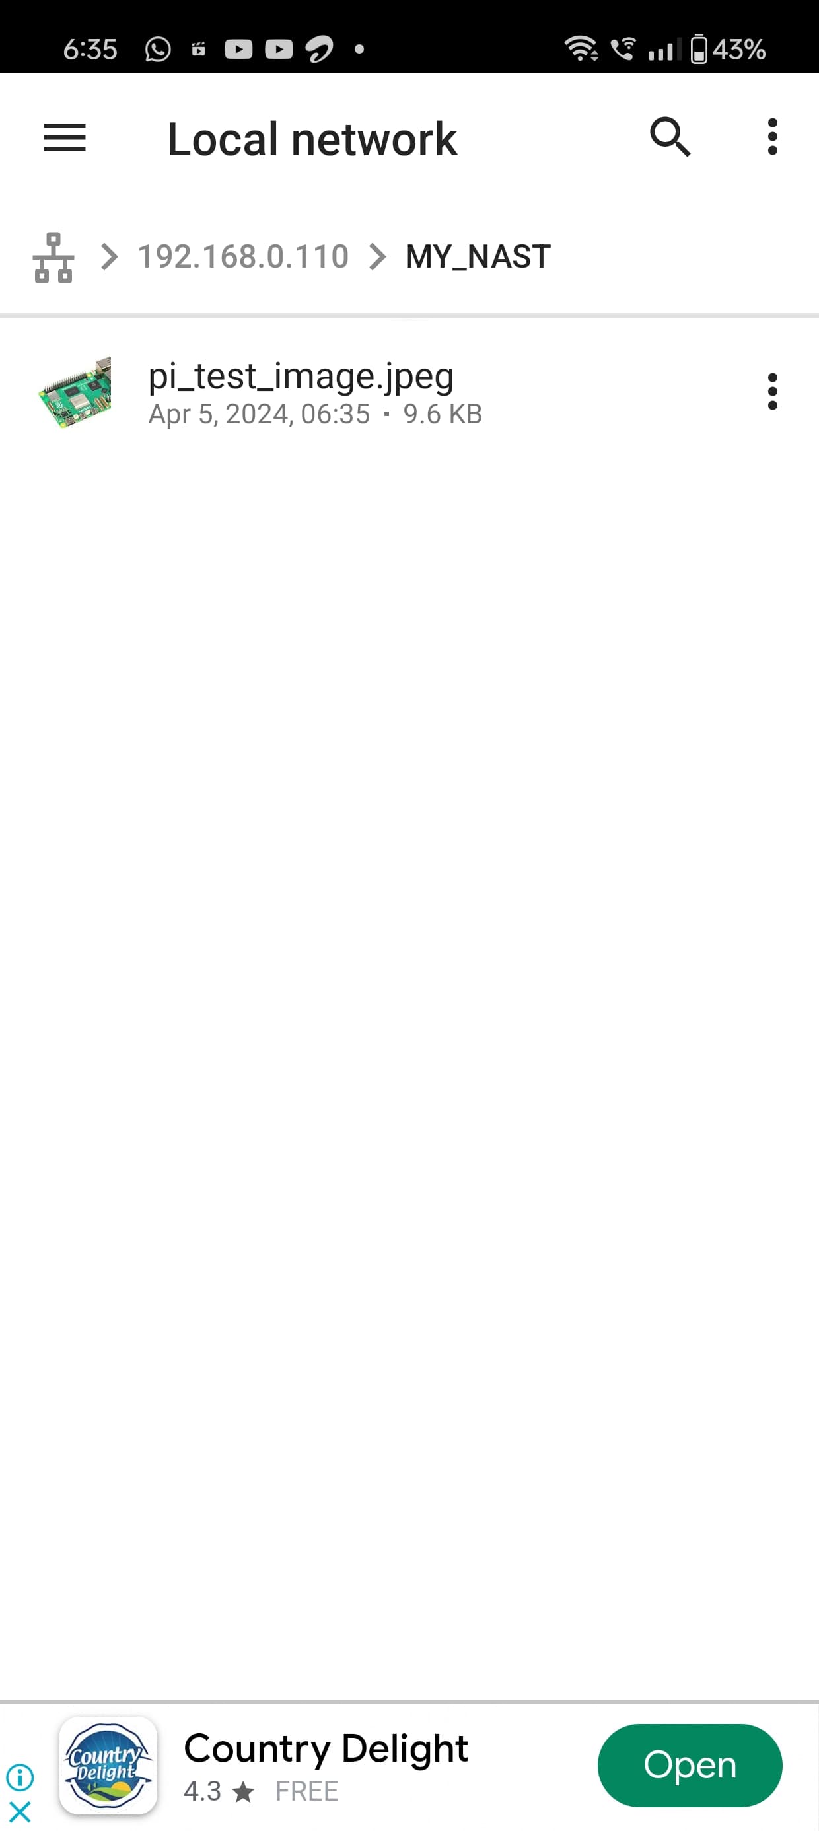

Slide 22
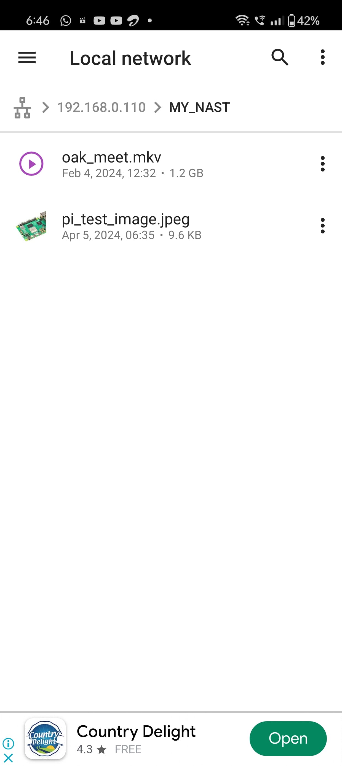

Slide 23
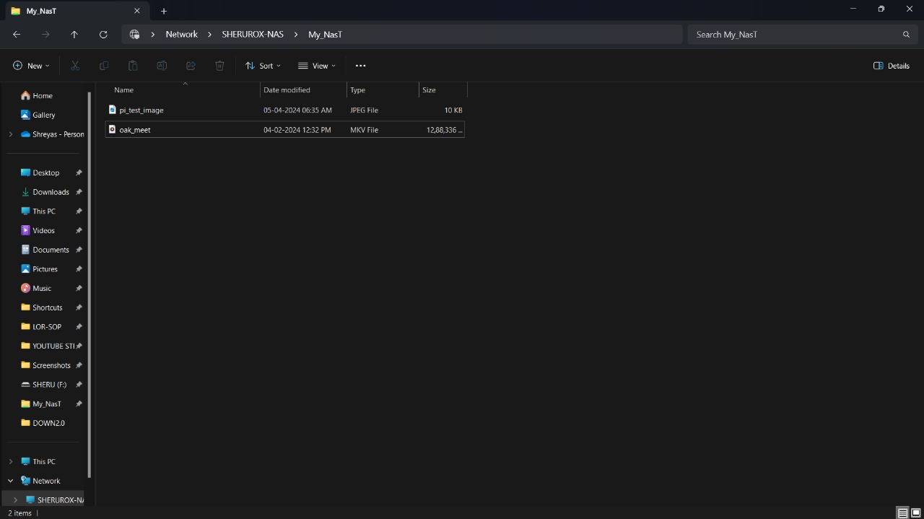

Slide 24
Different types of Storage Devices
The data transfer speeds from a Raspberry Pi Model 3 to various storage devices are influenced by factors such as the storage medium itself, the interface used to connect the storage, and the efficiency of the file transfer protocols. Here's a general overview of the expected speeds for different storage devices:
Storage | Explanation
MicroSD Card | The speed can vary depending on the quality and class of the microSD card. Class 10 microSD cards, commonly used with Raspberry Pi devices.
SSD(Solid State Drive) | When connecting an SSD to the Raspberry Pi Model 3 via the USB 2.0 ports, the transfer speed will be limited by the USB 2.0 interface.
USB Flash Drive (Pendrive): | USB flash drives typically use USB 2.0 or USB 3.0 interfaces.
HDD(Hard Disk Drive) | Connecting an HDD to the Raspberry Pi Model 3 via the USB 2.0 ports.

Slide 25
Sr.no | Storage Transfer Speeds
 | Type of Storage | Observed speed (in mb/ps) | Theoretical speed (in mb/ps)
1. | 8 GB SD Card | 9-12 | 50-70
2. | 32 GB Pen Drive | 10-15 | 50-70
3. | 480 GB SSD | 300-400 | 500-550
4. | 1 TB HDD | 100-150 | 150-200

Slide 26
Reference Paper | Author | Limitations | How I over came it
A NAS Integrated File System for On-site IoT Data Storage | Yuki Okamoto1 Kenichi Arai2 Toru Kobayashi2 Takuya Fujihashi1 Takashi Watanabe1 Shunsuke Saruwatari1 | Only to be used for fully functional Business owners and not for amateur entrepreneur. | Building a Nas as an enterprise oriented solutions, can be highly customizable and scalable
Research on online cloud storage technology | ZOU Shan-hua1ˈ2 ,FANG Ning-sheng2ˈ3 ,GAO Wei-jie3 | Incomplete information available for each type of storage device. | We have implemented all types of storage device solution for an optimal NAS
Remotely Accessible, Low Power Network Attached Storage Device | Anirudh Lanka, Arjun Gargeyas | No solution available for a backup source of power | Implementation of a backup source of power

Slide 27
Research papers referred:
D. Anderson, "Task force on network storage architecture: network attached storage is inevitable," Proceedings of the Thirtieth Hawaii International Conference on System Sciences, Wailea, HI, USA, 1997, pp. 725 vol.1-, doi: 10.1109/HICSS.1997.667470.
D. -z. Han and J. -z. Huang, "Security for the Storage Network Merging NAS and SAN," 2006 International Conference on Machine Learning and Cybernetics, Dalian, China, 2006, pp. 736-741, doi: 10.1109/ICMLC.2006.258445.
J. C. Talwana and H. J. Hua, "Smart World of Internet of Things (IoT) and Its Security Concerns," 2016 IEEE International Conference on Internet of Things (iThings) and IEEE Green Computing and Communications (GreenCom) and IEEE Cyber, Physical and Social Computing (CPSCom) and IEEE Smart Data (SmartData), Chengdu, China, 2016, pp. 240-245, doi: 10.1109/iThings-GreenCom-CPSCom-SmartData.2016.64.
Y. Okamoto, K. Arai, T. Kobayashi, T. Fujihashi, T. Watanabe and S. Saruwatari, "A NAS Integrated File System for On-site IoT Data Storage," 2020 IEEE International Conference on Pervasive Computing and Communications Workshops (PerCom Workshops), Austin, TX, USA, 2020, pp. 1-7, doi: 10.1109/PerComWorkshops48775.2020.9156143.
Gang Ma and A. L. Narasimha Reddy, "An evaluation of storage systems based on network-attached disks," Proceedings. 1998 International Conference on Parallel Processing (Cat. No.98EX205), Minneapolis, MN, USA, 1998, pp. 278-285, doi: 10.1109/ICPP.1998.708497.
A. Lanka and A. Gargeyas, "Remotely Accessible, Low Power Network Attached Storage Device," 2018 Second International Conference on Inventive Communication and Computational Technologies (ICICCT), Coimbatore, India, 2018, pp. 1083-1088, doi: 10.1109/ICICCT.2018.8473164.
F. Yuan, "The construction of the network storage system in the data centers of colleges and universities," 2011 IEEE 3rd International Conference on Communication Software and Networks, Xi'an, China, 2011, pp. 208-211, doi: 10.1109/ICCSN.2011.6014253.
S. -H. Zou, N. -S. Fang and W. -J. Gao, "Research on online cloud storage technology," 2020 19th International Symposium on Distributed Computing and Applications for Business Engineering and Science (DCABES), Xuzhou, China, 2020, pp. 62-65, doi: 10.1109/DCABES50732.2020.00025.
M. Saraswat and R. C. Tripathi, "Cloud Computing: Analysis of Top 5 CSPs in SaaS, PaaS and IaaS Platforms," 2020 9th International Conference System Modeling and Advancement in Research Trends (SMART), Moradabad, India, 2020, pp. 300-305, doi: 10.1109/SMART50582.2020.9337157.
C. Sharma and N. K. Gondhi, "Communication Protocol Stack for Constrained IoT Systems," 2018 3rd International Conference On Internet of Things: Smart Innovation and Usages (IoT-SIU), Bhimtal, India, 2018, pp. 1-6, doi: 10.1109/IoT-SIU.2018.8519904.

